Slide 1

Portfolio Webpage
Restaurant Portfolio

Slide 2
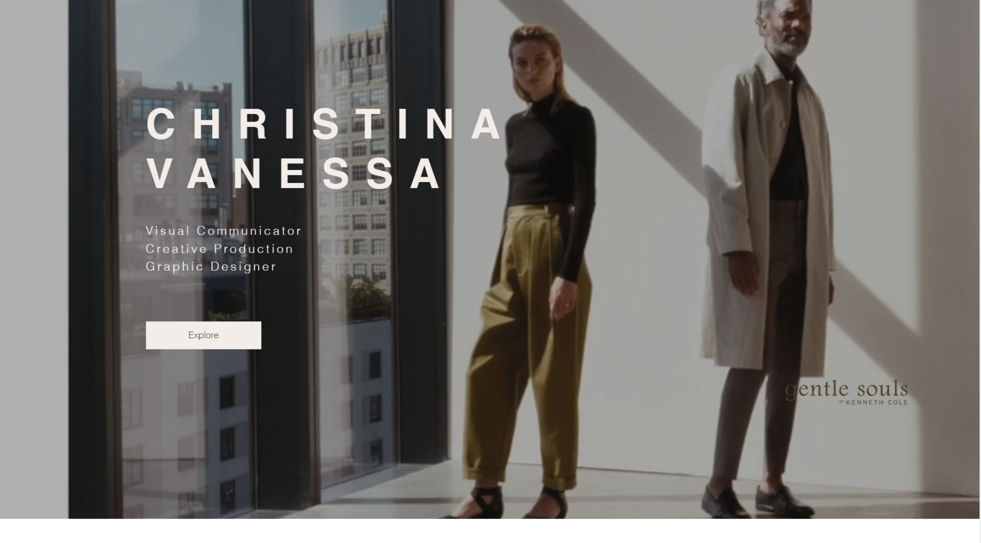
Design Overview
Idea for design: having a cover image or video in the background of the beginning of the page followed by a menu and an online order section.

Slide 3
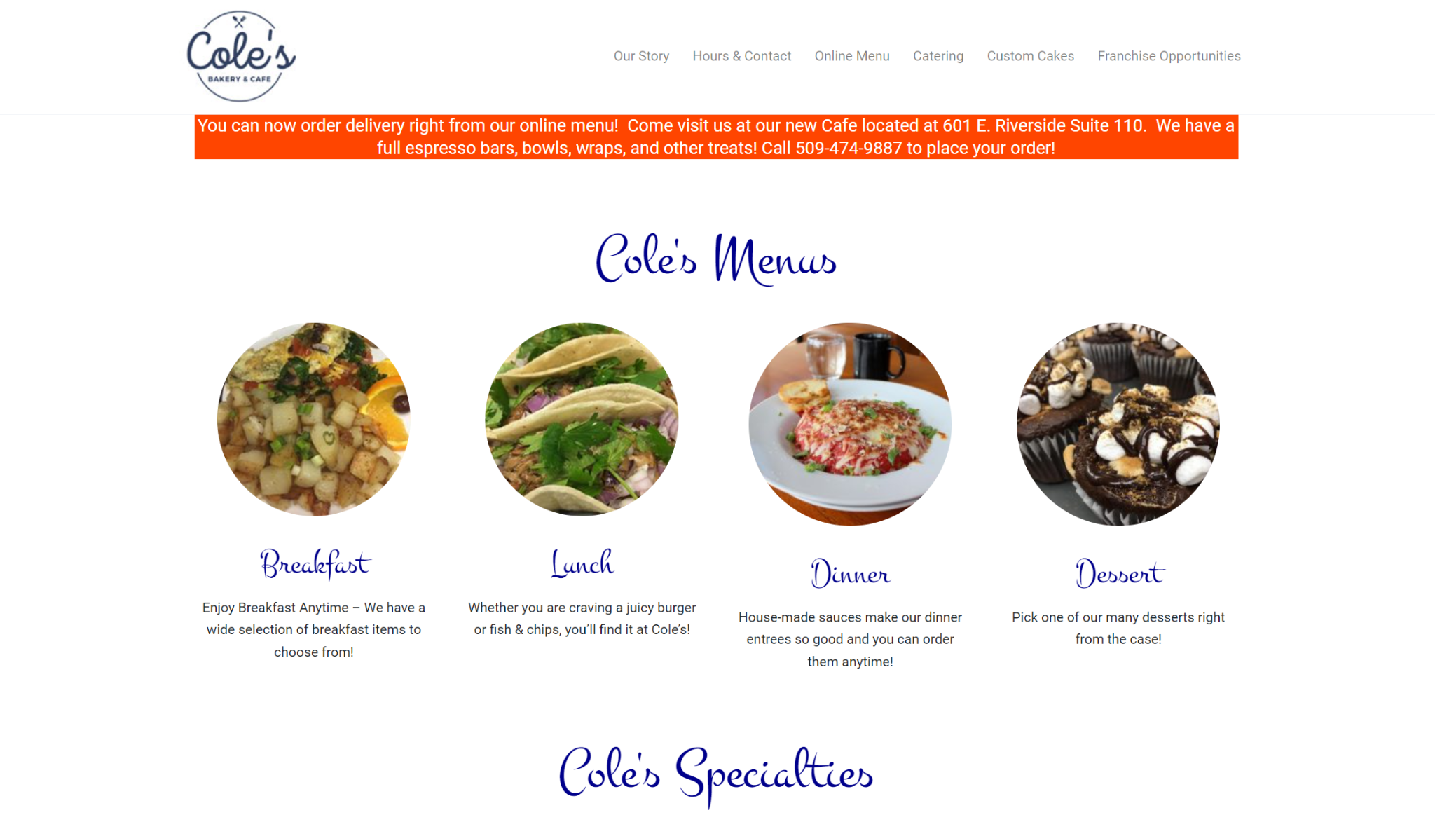
Features
Login for orders
Menu for restaurant
Pictures of food
Hours and location
Pretty animations

Slide 4
Roles and overall goals
Lead: Athraa N.
Frontend: Sean O.
UX design: RJ B.
Backend 1: Trevor F
Backend 2: Hunter T

Slide 5
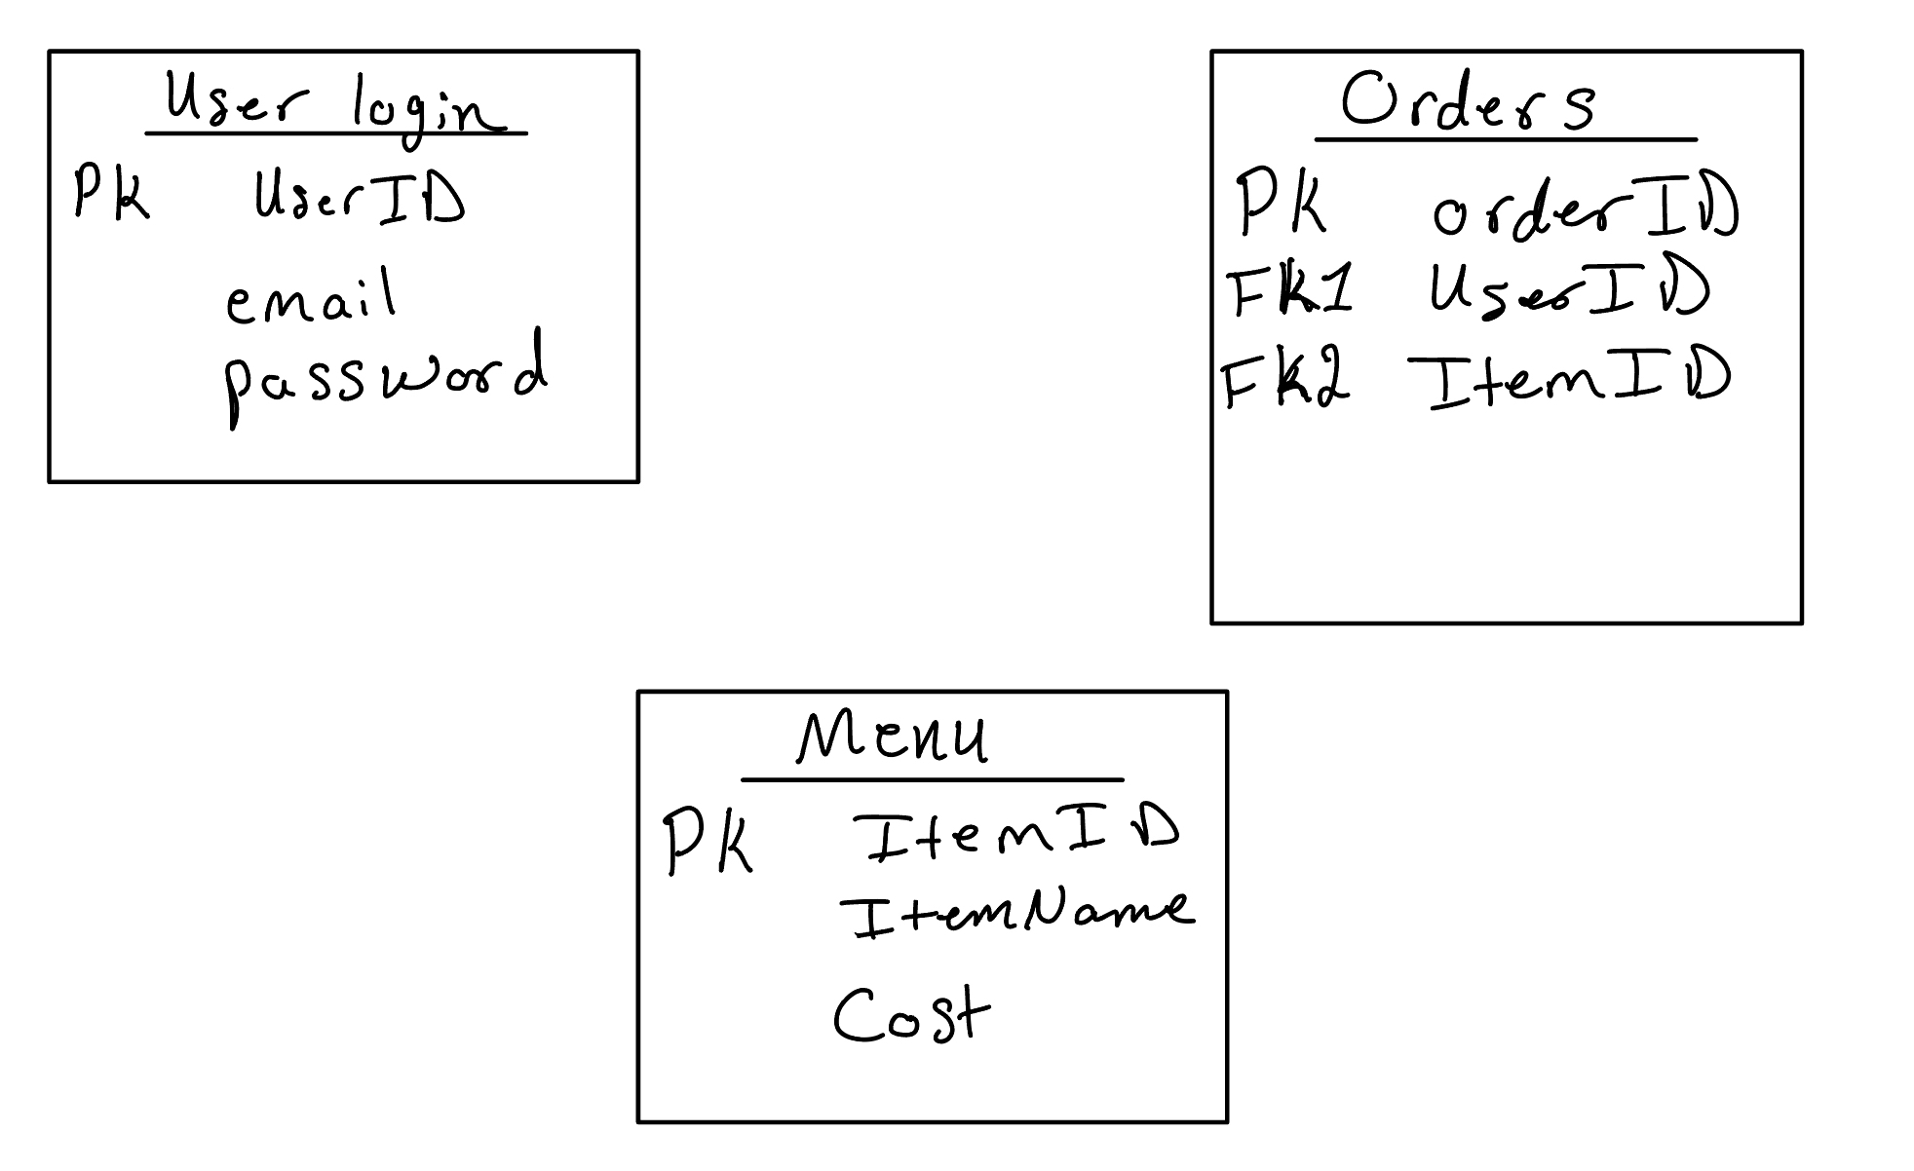
Implementation
Database structure:
Resources Overview:
Front-end: HTML, CSS and React
Back-end: PHP and MySQL and JavaScript

